Slide 1
Introduction of Internal Medicine
By
Dr. Hussein AlNaji

Slide 2
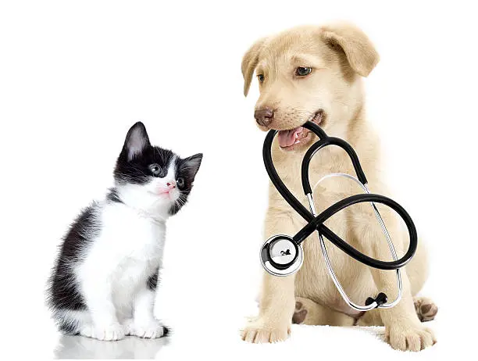
Internal Medicine
Internal medicine or general internal medicine is the medical specialty dealing with the prevention, diagnosis, and treatment of internal diseases.
Anorexia Lack or loss of appetite for food.
Borborygmus A rumbling noise caused by the propulsion of gas through the stomach and intestines .
Constipation Infrequent or difficult evacuation of the feces.
Coprophagy The ingestion of feces.

Slide 3
Diarrhea The passage of feces that contain an excess amount of water,resulting in an abnormal increase in stool liquidity and weight.
Dyschezia Difficult or painful evacuation of feces from the rectum
Dysphagia Difficulty in swallowing
Flatulence The presence of excessive amounts of air or gases in the stomach or intestine, leading to distention of the organs.
Flatus Gas or air expelled through the anus
Hematemesis The vomiting of blood.
Hematochezia The passage of bright-red blood with the stools.

Slide 4
Jaundice A syndrome characterized by hyperbilirubinemia and deposition of bile pigment in the skin, mucous membranes,and sclera with resulting yellow appearance of the patient (also called icterus).
Melena The passage of black, tarry stools resulting from digested blood.
Obstipation Intractable constipation resulting from prolonged constipation, with progressive enlargement, drying, and hardening of the fecal mass.
Odynophagia: Pain on swallowing
Pica: A craving for unnatural articles of food;a depraved appetite

Slide 5
Polyphagia: Excessive or voracious eating
Pseudocoprostasis: A mechanical obstruction of the anus by hair matted with drying fecal material
Pseudoptyalism: Failure to swallow saliva produced in normal amounts
Ptyalism: Excessive secretion of saliva (also called hypersalivation, sialorrhea).
Regurgitation: The effortless expulsion of ingesta from the esophagus
Tenesmus: Straining, especially ineffectual and painful straining, to pass stool (or urine)
Vomiting: The forcible expulsion of the contents of the stomach through the mouth
Xerostomia: Dryness of the mouth from lack of secretions

Slide 6
BODY TEMPERATURE
Farm animals maintain a relatively constant body core temperature (homeothermy) during extreme ranges of thermal environments.
The body temperature is a reflection of the balance between heat gain from the environment (radiation, conduction, and convection) or caused by metabolic activity (maintenance, exercise, growth, lactation, gestation, and feeding) and heat loss to the environment (radiation, conduction, convection, and evaporation) or caused by metabolic activity (milk removal, fecal elimination, and urinary elimination).
Absorption of heat from the environment occurs when the external temperature rises above that of the body.

Slide 7
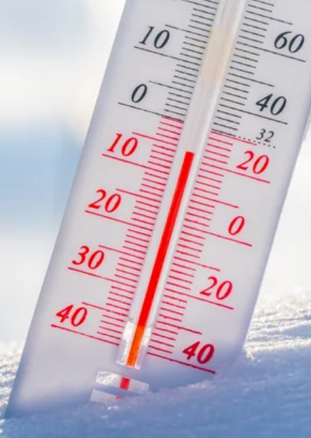
HEAT PRODUCTION
Heat production occurs as a result of
metabolic activity and the digestion of feed
muscular movement.
the maintenance of muscle tone.
Shivering thermogenesis is a response to sudden exposure to cold and is a major contributor to enhanced heat production.
Nonshivering thermogenesis is also induced by exposure to cold and is the mechanism by which heat is produced by the calorigenic effect of epinephrine and norepinephrine.

Slide 8

HEAT LOSS
Heat is transferred to or from an animal by the four standard physical phenomena of convection, conduction, radiation, and evaporation.
Convection is a transfer of heat between two media at different temperatures such as the coat surface and the air.
Conduction is the transfer of heat between two media that are in direct contact such as the skin and water.

Slide 9

C. Radiation is the absorption or emission of electromagnetic radiation at the body surface and depends on the skin surface temperature and area.
D. Evaporative heat transfer is a process by which heat is lost by the evaporation of water and is dependent on the water vapor pressure gradient between the epithelial surface and the environment and the air speed over the surface.
Evaporation occurs by sweating, salivation, and respiration, with the relative importance of each varying between species

Slide 10
HYPOTHERMIA
Hypothermia is a lower than normal body temperature, which occurs when excess heat is lost or insufficient heat is produced.
Neonatal hypothermia is a major cause of morbidity and mortality in newborn farm animals within the first few days of life. Cold injury and frostbite are presented under that heading.
ETIOLOGY
A. Excessive Loss of Heat
Exposure to excessively cold air temperatures causes
heat loss if increased metabolic activity.
shivering and sustained muscular contraction.
peripheral vasoconstriction are unable to compensate.

Slide 11
B. Insufficient Heat Production
Insufficient body reserves of energy and insufficient feed intake result in insufficient heat production.
Hypothermia also occurs secondary to many diseases in which there
may be a decrease in the ability to shiver and skeletal muscle contraction associated with decreased cardiac output, decreased peripheral perfusion, and shock.
Combination of Excessive Heat Loss and Insufficient Heat Production
A combination of excessive heat loss and insufficient heat production is often the cause of hypothermia. Insufficient energy intake or starvation of newborn farm animals in a cold environment can be a major cause of hypothermia.

Slide 12
CLINICAL FINDINGS
A decrease in body temperature to below 37°C represents hypothermia for most farm animal species.
Weakness, decreased activity, cold extremities, and varying degrees of shock are common.
Bradycardia, weak arterial pulse, and collapse of the major veins are characteristic.
The mucous membranes of the oral cavity are cool and there is a lack of saliva.

Slide 13
Diagnostic confirmation
Clinical findings and history of exposure to cold.
Treatment
Warm, dry environment. Improve peripheral circulation.
Control
Remove debilitated calves from cold environments. Adequate and dry bedding.

Slide 14


